Slide 1

Module 5
Practical Applications
Office Hours with Viviana Márquez
May 2, 2024
PROFESSIONAL CERTIFICATE
IN MACHINE LEARNING AND
ARTIFICIAL INTELLIGENCE

Slide 2


on finishing
Section 1: Foundations of ML/AI
Break week: May 8 - May 14
Please enjoy this short break before the launch of the next module. You can use time to catch up with assignments, review videos or peruse resources you may not have had the chance to look through. No new activity or content is released this week.

Slide 3
on finishing
Section 1: Foundations of ML/AI
Break week: May 8 - May 14
Please enjoy this short break before the launch of the next module. You can use time to catch up with assignments, review videos or peruse resources you may not have had the chance to look through. No new activity or content is released this week.
Next Section
Section 2: ML/AI Techniques

Slide 4
AGENDA
Required activities for Module 5
Content review Module 5: Practical Applications I
Questions

Slide 5
Required Activities for Module 5
👩‍🏫 Practical Application Assignment 5.1: Will the Customer Accept the Coupon?
🤍 Activity 5.1: Setting up your GitHub Portfolio
https://classroom.emeritus.org/courses/6063/assignments/212728?module_item_id=1513343

Slide 6
Content review Module 5: Practical Applications I
Version Control
Git
GitHub

Slide 7
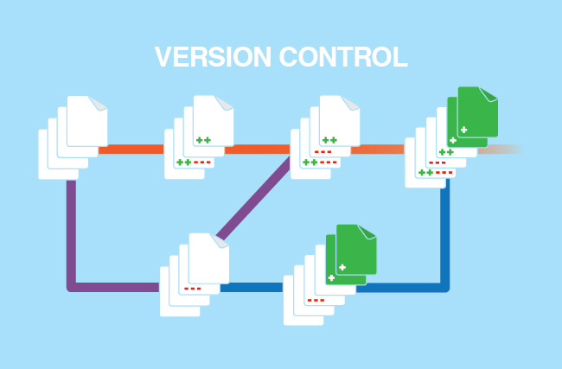
The importance of Version Control
System to track changes in files over time during software development
Allows multiple people to work on the same project without stepping on each other's toes
Facilitates easy rollback, collaboration, and parallel work

Slide 8

Git
Git is the most popular Version Control system nowadays
Specifically, it's a Distributed Version Control System (DVCS), meaning every working copy of the codebase is a complete repository with full history
A command-line tool (though there are GUI versions available) that manages source code history
Can be used independently of any online platform

Slide 9

GitHub
GitHub is a platform that provides hosting for software development version control using Git. It allows multiple people to work on projects simultaneously, without interfering with each other's work
It's the world's leading software development platform with millions of developers hosting and reviewing code, managing projects, and building software
Offers a user-friendly interface and additional features like pull requests, issue tracking, and integrations with other developer tools
While it's built around Git, using GitHub also means using Git, but the reverse isn't necessarily true. One can use Git without ever touching GitHub

Slide 10
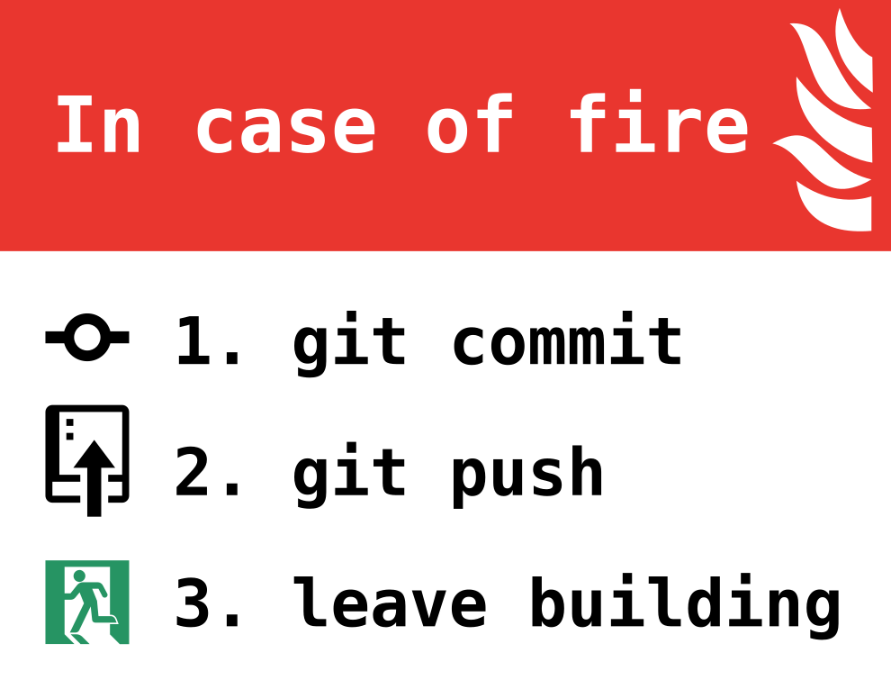
GitHub – Importance in Data Science
Collaboration: Data scientists often work on teams and need a platform to collaborate, share code, and maintain versions of their scripts, notebooks, and data
Reproducibility: GitHub ensures that there's a record of code changes, allowing for transparency and reproducibility in data science tasks
Portfolio Building: For budding data scientists, having a GitHub profile can serve as a portfolio of their projects, demonstrating their coding and analytical skills to potential employers

Slide 11
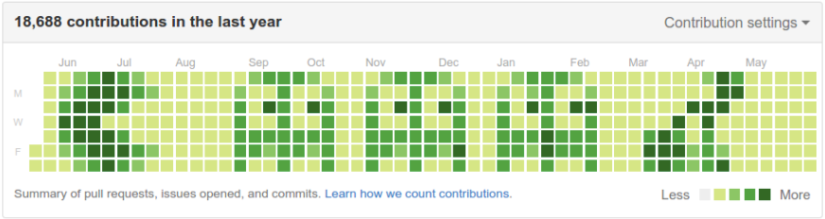
GitHub – Basic terminology
Repository (Repo): A directory or storage space where your project lives
Commit: A saved change to your repo
Branch: A parallel version of a repository
Pull Request (PR): Proposing your changes and requesting that someone review and pull in your contribution
Merge: Merging your changes back to the main (master) branch
Fork: A personal copy of another user's repository that lives on your account
Clone: A copy of a repo that exists on your local computer

Slide 12
GitHub Pages
GitHub Pages is a static site hosting service offered by GitHub. It allows users to transform their GitHub repositories into websites
By default, the URL of your GitHub Pages site will be in the format username.github.io/repository-name. However, you can also set up a custom domain if you want a more professional or personalized URL
GitHub Pages is free for public repositories, but there are some limitations
Documentation: https://docs.github.com/en/pages/getting-started-with-github-pages/creating-a-github-pages-site
Examples: https://github.com/collections/github-pages-examples

Slide 13
GitHub – Safety and Etiquette
Do not upload sensitive information: Never commit passwords, API keys, or any other sensitive information to public repos
READMEs and Licensing: Create clear README files for every repo and the understanding of software licensing
Respectful Collaboration: Be kind, understanding, and patient when collaborating on shared projects

Slide 14
GitHub – Resources
Command Line: MAC vs Windows https://tracer.gitbook.io/manual/support/command-line-mac-vs.-windows
Is a Mac or Windows PC Better for Programming? https://medium.com/geekculture/is-a-mac-or-windows-pc-better-for-programming-d5556bf06f1#:~:text=The%20Operating%20System%3A%20macOS%20vs,benefit%20of%20macOS%20is%20security
Installing Git https://git-scm.com/downloads

Slide 15
GitHub – Getting started!
Sign in or create an account at: https://github.com/
Configure Git with your username and email (important for commit messages):
git config --global user.name "Your Name"
git config --global user.email "youremail@example.com"
Create a new repository
git clone https://github.com/username/repository-name.git
Make Changes and Commit
git add .
git commit -m "A descriptive message about the changes."
git push origin main
Fetches Changes
git pull

Slide 16

QUESTIONS?

